Slide 1

Work and Wealth Insights
By: Keegan, Natasha, Lishi & Mike
Notes:
Hi everyone, Welcome to our project (Project name),

Slide 2
Introduction
01
02
03
Project Goal: Predict discretionary spending using employment data
Achieve at least 0.8 R2
Data Sources: Labour Force Data, Lending Indicators (ABS)
Notes:
In this project our project goal was to Predict discretionary spending using employment data.
We wanted to Achieve at least 0.8 R-Squared (R2)
And Our data was sourced from the australian bureau of statistics.

Slide 3
Problem Statement
Does employment impact household discretionary spending?
Can machine learning accurately predict spending trends?
What features are most important for predictions?
Notes:
Our problem statement we wanted to solve was:
How does employment impact household discretionary spending?
Can machine learning accurately predict spending trends?
And What features are most important for predictions?

Slide 4
About the Data
Datasets were obtained from Australian Bureau of Statistics
Data included Employment statistics, Economic indicators, and Financial data
Merged data included 120 entries and 8 columns
Notes:
With the data we sourced. We chose The Australian Bureau of Statistics (ABS) as it provides reliable, government-backed data, making it a credible source for economic and employment analysis.
The datasets help identify trends in employment, spending, and loan values, which are key indicators of economic health.
We would be able to see if employment levels were increasing or decreasing over time, how employment rates differ between men and women and Does employment influence consumer spending on essentials?
With the obtained datasets, we connected each one by using JOINS with Pandas SQL. By doing this we created a more comprehensive view of how employment correlates with financial trends.
Our combined data included employment statistics, economic indicators and financial data with 120 entries and 8 columns.
And more about the Data, I will now pass on the next slide to Natasha.

Slide 5

Data Collection & Preprocessing
Merged datasets on 'Time Period'
No missing values detected
Normalized numerical features for better modeling

Slide 6

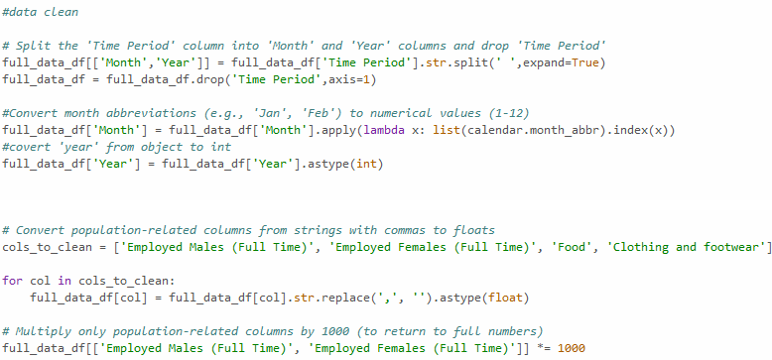
Data Cleaning & ETL
Commas were removed from numbers for processing
Data was changed to appropriate data type (float)
Outliers were removed after analysis

Slide 7
Features
1. Employed Males (Full Time)
2. Employed Females (Full Time)
3. Employment to Population Ratio (Male)
4. Employment to Population Ratio (Female)
5. Clothing and Footwear Expenditure
6. Food Expenditure
Label: Total Value of Travel Loans
Notes:
-In order to predict if discretionary spending was related to employment data, we picked these features to investigate. To have a more holistic view of employment we chose the total amount of employed Males and Females in Full Time roles, as well as the ratio of employed people to the general population. We believed that this would give us a precise view of stable income across Australia.
-To help model monthly spending habits, we chose to look at household spending on food (necessary spending) and clothing/footwear (discretionary spending).
-Using these features we set out to create a model that would help us predict the total value of Travel Loans in relation to employment.

Slide 8
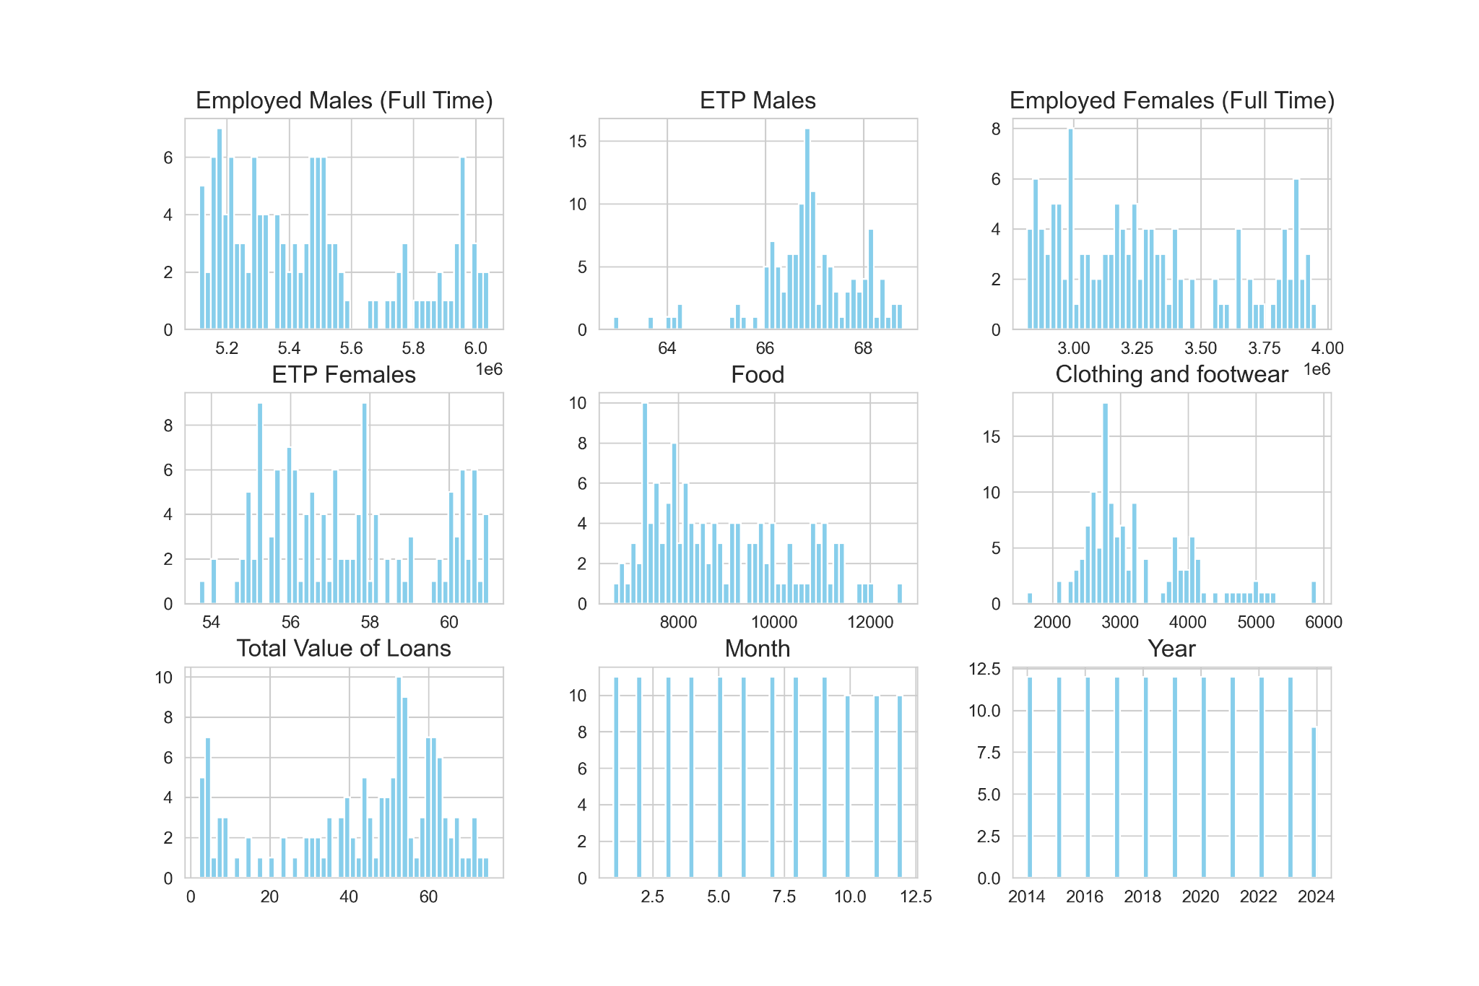
Features and Data Distribution
Notes:
-We analysed our input data and looked at how each piece of information we were ingesting correlated to all other data columns. -First we created histograms to be able to visualise our data on an individual basis, allowing us to have an overview of the individual pieces of data that would be driving our model. -From here, we were able to do an analysis on each feature to determine any outliers.

Slide 9
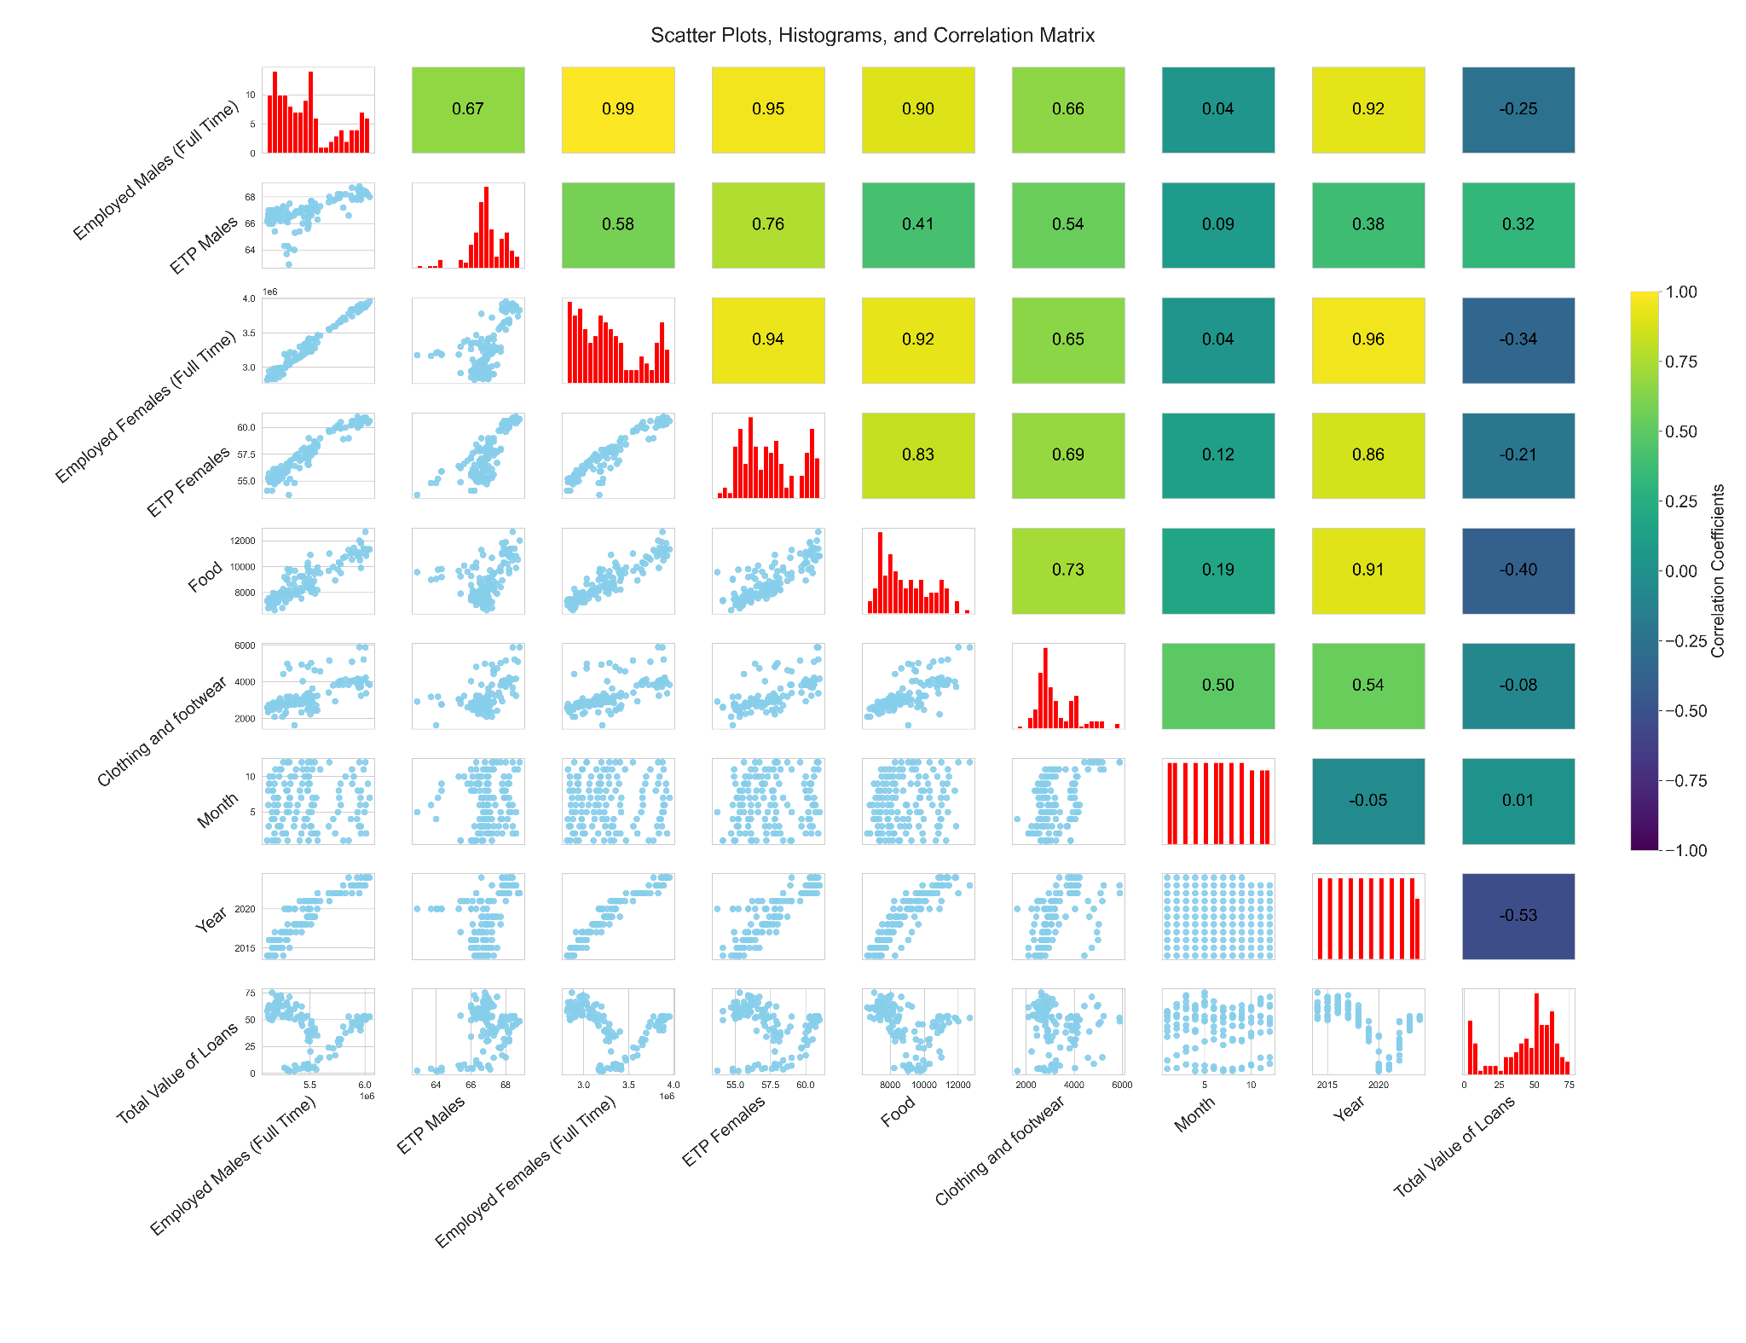
Notes:
-After this, we created a correlation matrix in order to more closely look at the relationship between each piece of information we were feeding to our model. -As shown on this slide, the models with a more ‘yellow’ colour are more positively correlated, while those with a more 'purple' colour are negatively correlated. -From this, we can see high correlation between the Amount of Employed females and general household spending, and low correlations between the time period and the trends of the data.

Slide 10


Slide 11
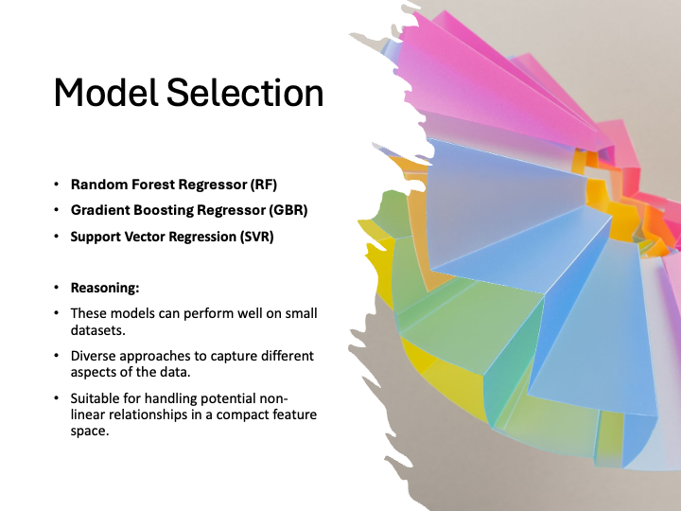

Slide 12
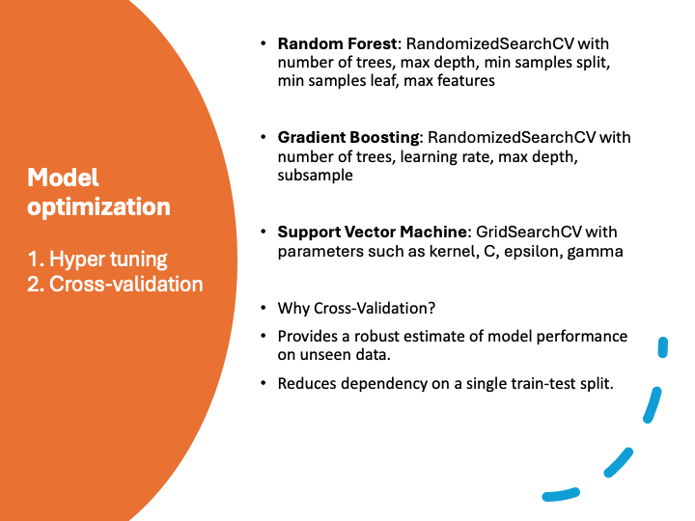

Slide 13
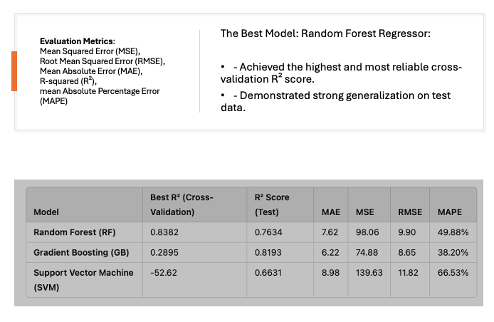
Evaluate model performance

Slide 14
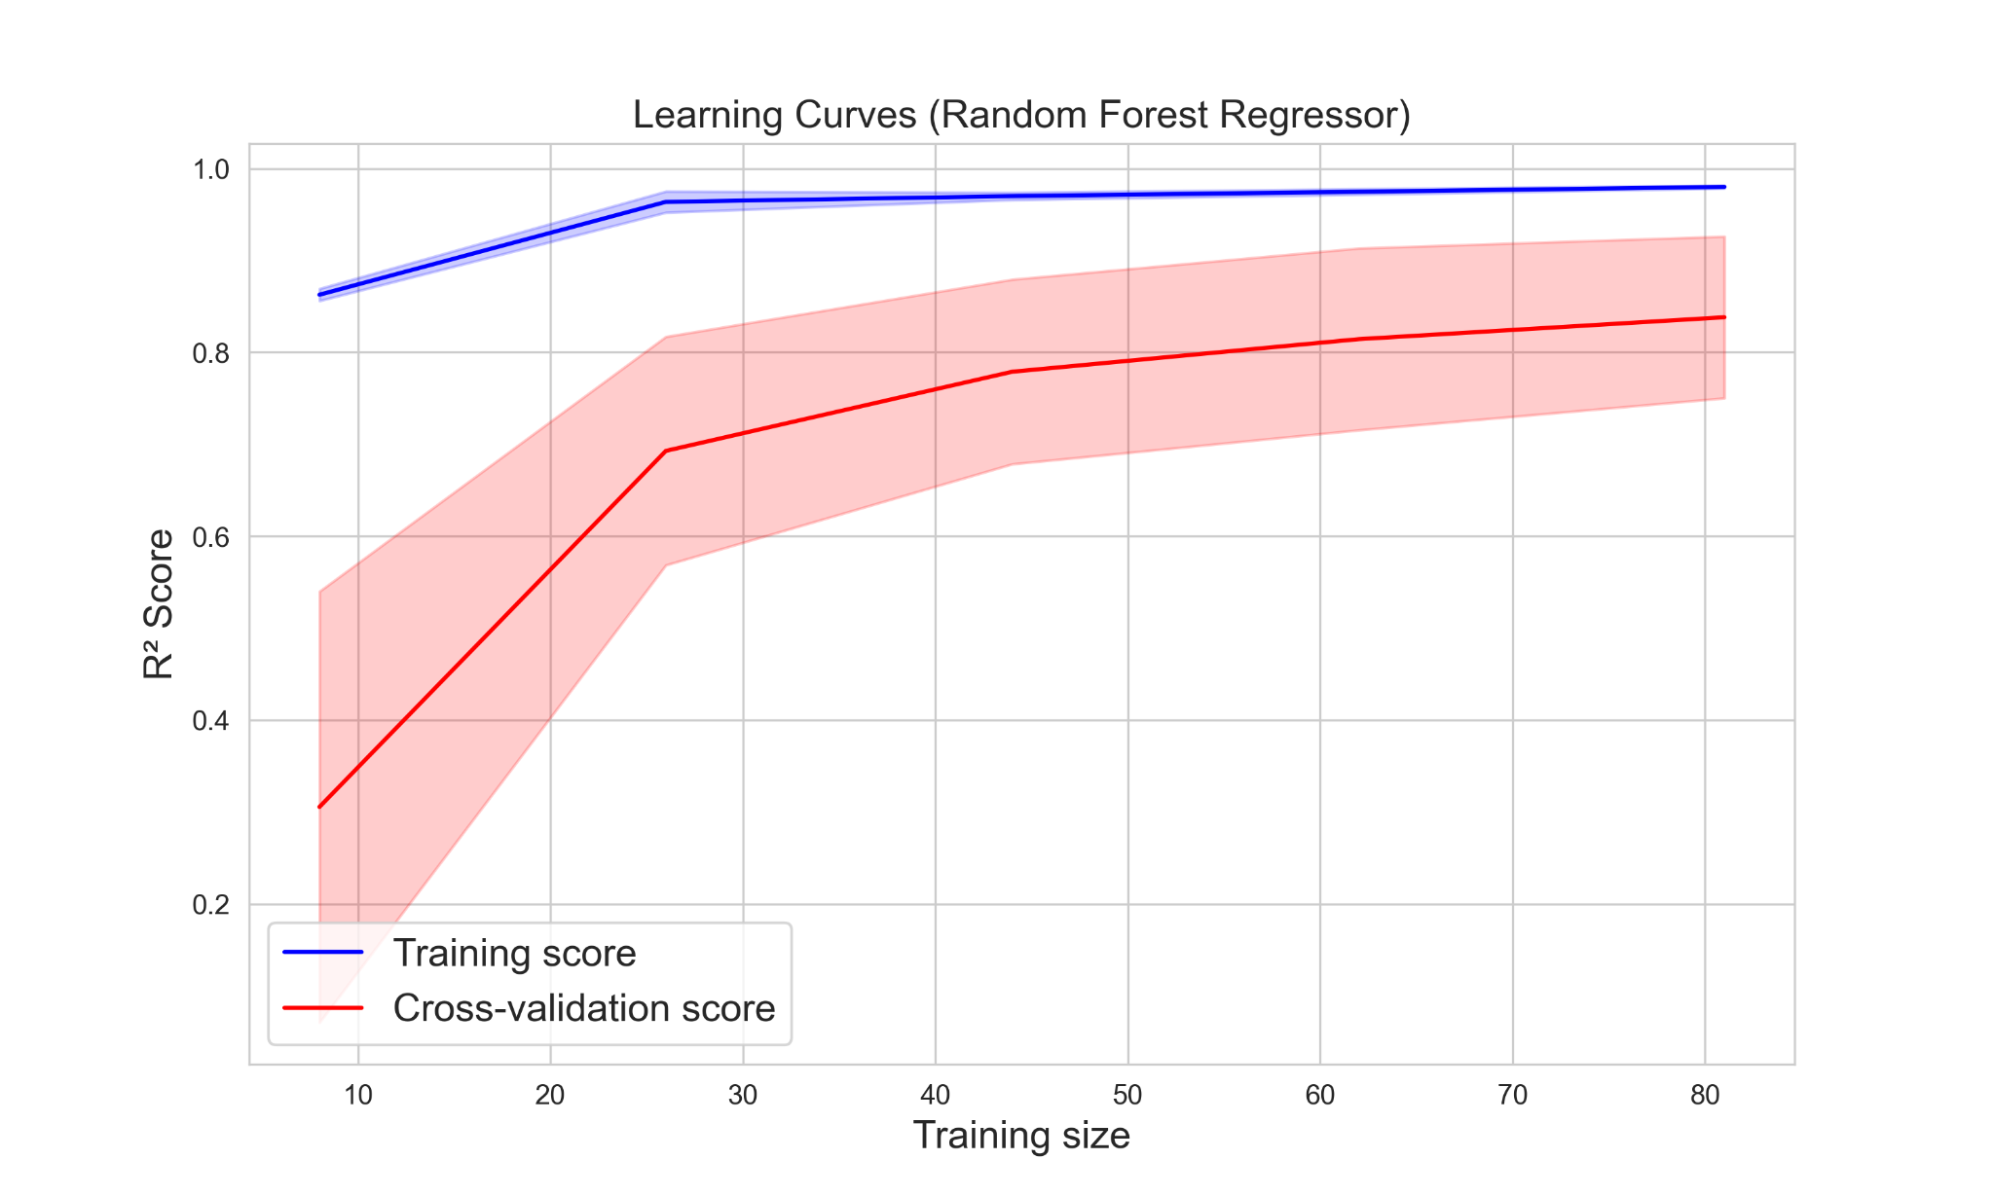

Slide 15
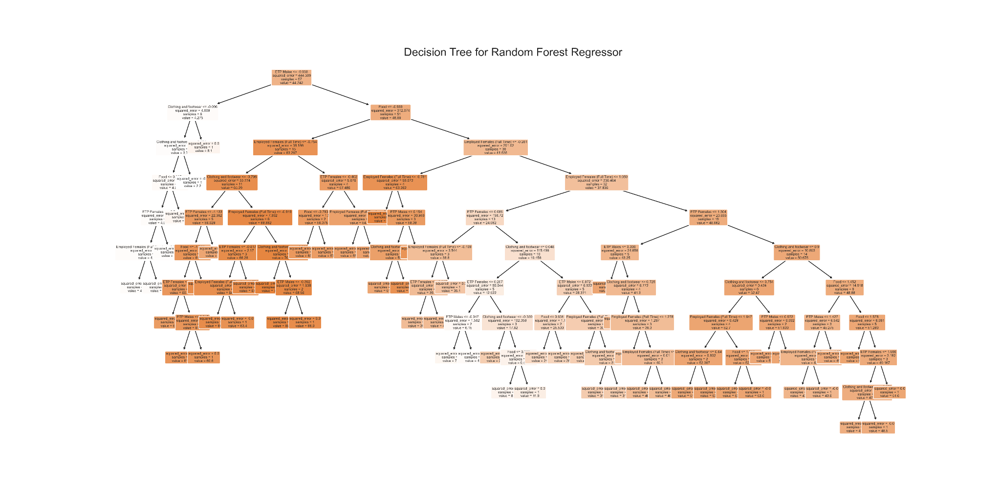
Best Model Visualised

Slide 16
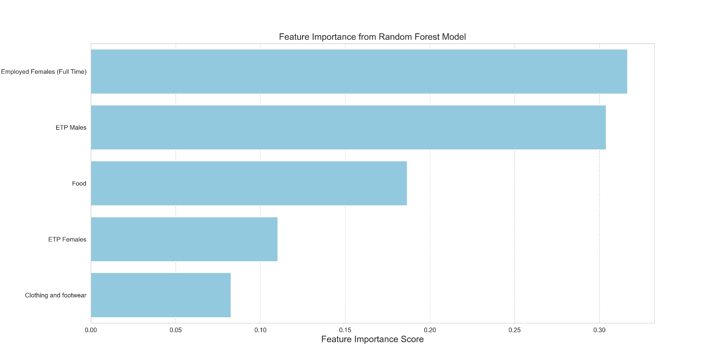
Feature Importance

Slide 17
Key Findings
Random Forest Regressor Model was best
The most important feature was Employment of Full time Females.
There was a reasonable correlation between employment and total committed travel loans.

Slide 18
Next Steps/Limitations
Model performs reasonably well but room for improvement.
Consideration to time-series analysis to predict trends over time (challenges with this)
Consideration to other economic indicators of employment e.g. number of job adverts on seek
Broader range of data points for the definition of discretionary spending

Slide 19
Q&A
📢 Questions?

Slide 20
